Slide 1

41013 Robotics
Week 4

Slide 2
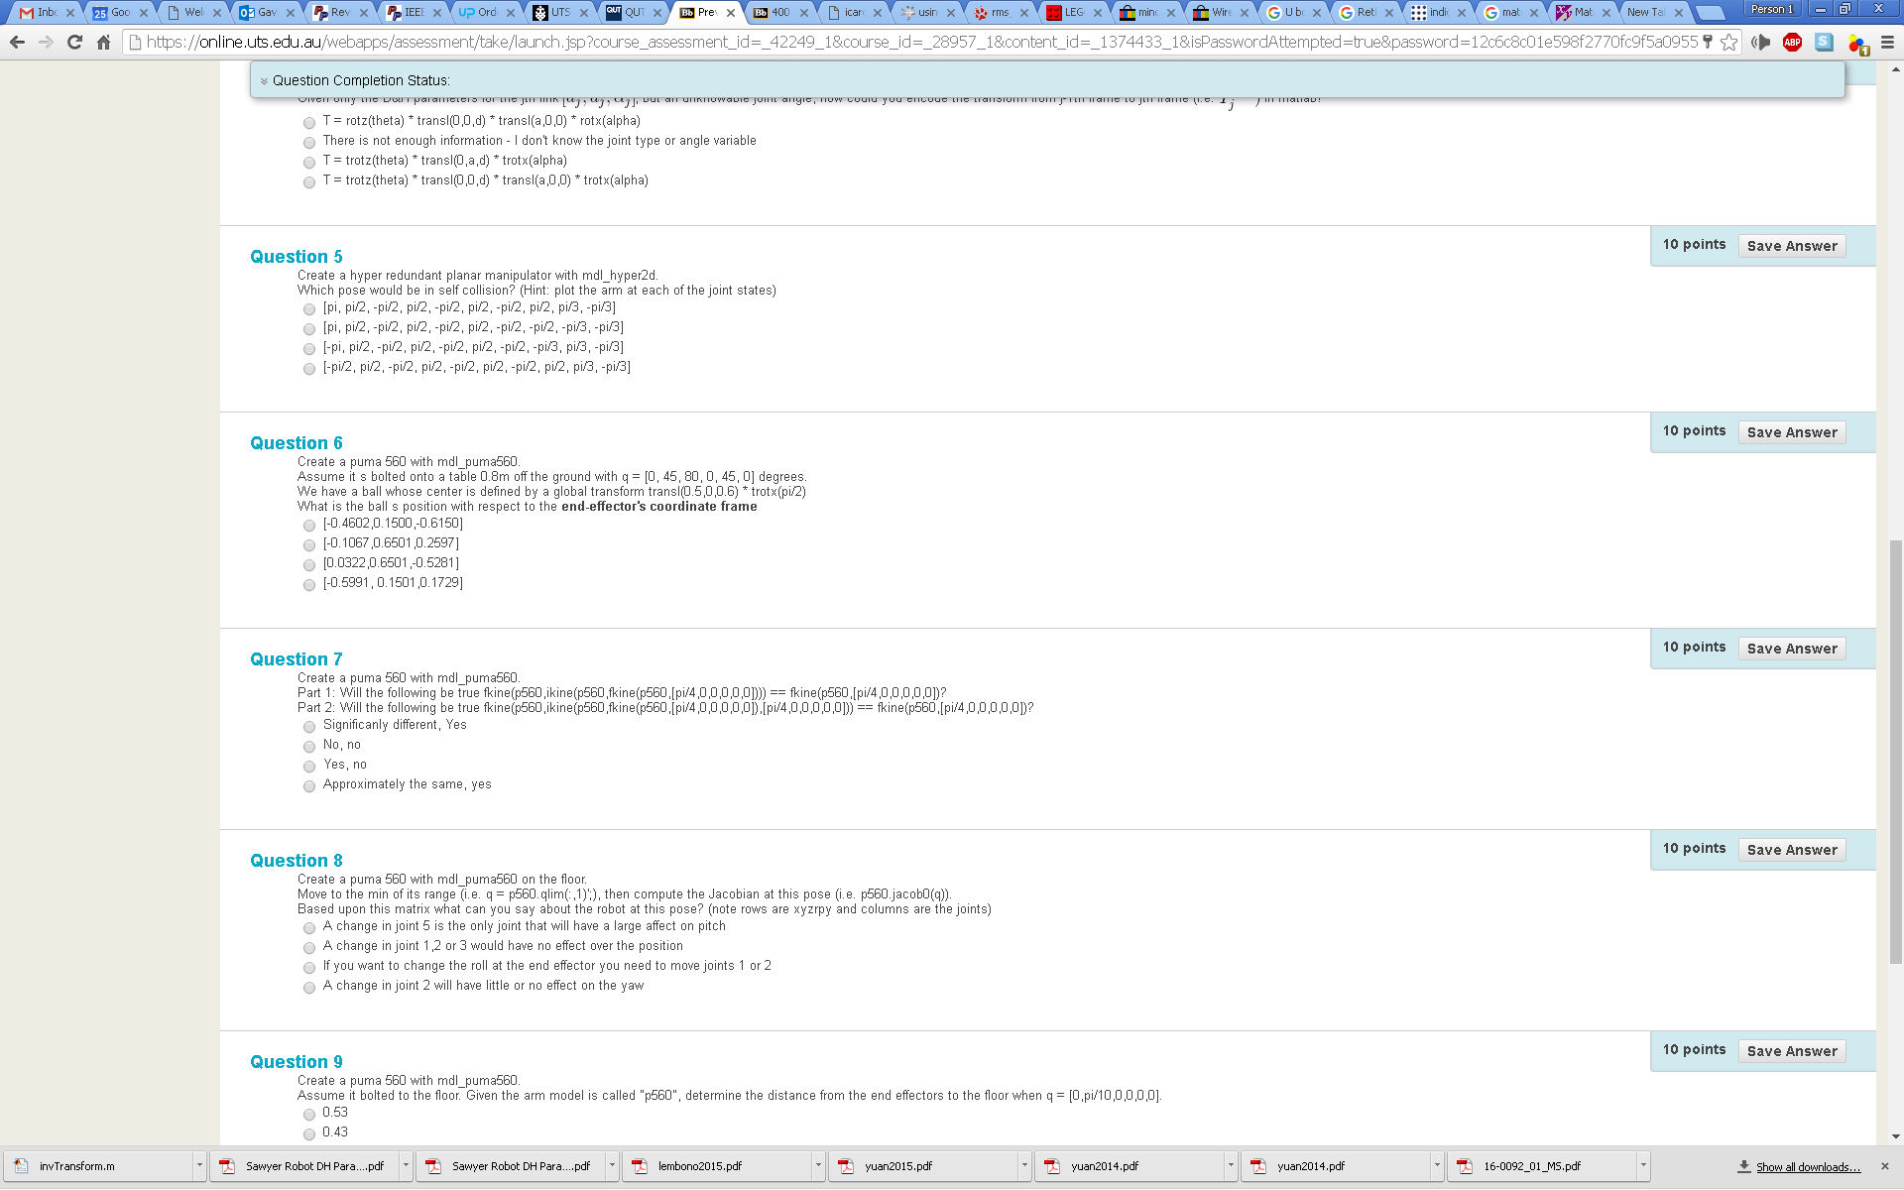
Example question

Slide 3
Point In Global Coordinate Frame
Consider a point in the global coordinate frame p= [0.6,0.4,0];
Point can be show (in blue) as transform, T_{p}
translated by [0.6,0.4,0];
No rotation (3x3 identity matrix)
Global transform, T_{G} is a
translation by [0,0,0];
No rotation (3x3 identity matrix)
Computed in matlab as
T_{p} Position in Global coordinate frame T_{G} | T_{p} Rotation in T_{G} | T_{p} in T_{G}
inv(eye(4)) * transl(0.6,0.4,0)
Example 0

Slide 4
Point in A New Coordinate Frame (with only translation & no rotation)
Consider a point in the global coordinate frame p= [0.6,0.4,0];
Point can be show (in blue) as transform, T_{p}
translated by [0.6,0.4,0];
No rotation (3x3 identity matrix)
New coordinate frame transform, T_{N} is a
translation by [1,1,0];
No rotation (3x3 identity matrix)
Computed in matlab as
T_{p} Position in New coordinate frame T_{N} | T_{p} Rotation in T_{N} | T_{p} in T_{N}
inv(transl(1,1,0)) * transl(0.6,0.4,0)
Example 1

Slide 5
Point in A New Coordinate Frame (with only rotation & no translation)
Consider a point in the global coordinate frame p= [0.6,0.4,0];
Point can be show (in blue) as transform, T_{p}
translated by [0.6,0.4,0];
No rotation (3x3 identity matrix)
New coordinate frame transform, T_{N} is a
translation by [0,0,0];
Rotation of pi/4 about global z axis
Computed in matlab as
T_{p} Position in New coordinate frame T_{N} | T_{p} Rotation in T_{N} | T_{p} in T_{N}
inv(trotz(pi/4)) * transl(0.6,0.4,0)
Example 2

Slide 6
Point in a New Coordinate Frame (with translation & rotation)
Consider a point in the global coordinate frame p= [0.6,0.4,0];
Point can be show (in blue) as transform, T_{p}
translated by [0.6,0.4,0];
No rotation (3x3 identity matrix)
New coordinate frame transform, T_{N} is a
translation by [1,1,0];
Rotation of pi/4 about global z axis
Computed in matlab as
T_{p} Position in New coordinate frame T_{N} | T_{p} Rotation in T_{N} | T_{p} in T_{N}
inv(transl(1,1,0) * trotz(pi/4)) * transl(0.6,0.4,0)
Example 3

Slide 7
3D Point in a New Coordinate Frame (with translation & rotation)
view(2)
Consider a point in the global coordinate frame p= [0.6,0.4,0.5];
Point can be show (in blue) as transform, T_{p}
translated by [0.6,0.4,0.5];
No rotation (3x3 identity matrix)
New coordinate frame transform, T_{N} is a
translation by [1.1,1.2,1.3];
Rotation of pi/4 about global z axis
Computed in matlab as
view(3)
T_{p} Position in New coordinate frame T_{N} | T_{p} Rotation in T_{N} | T_{p} in T_{N}
inv(transl(1.1,1.2,1.3) * trotz(pi/4)) * transl(0.6,0.4,0.5)
Example 4

Slide 8
Transform in a New Coordinate Frame (with translation & rotation)
view(2)
Consider a transform, T_{p} in the global coordinate frame show (in blue)
translated by [0.6,0.4,0.5];
Rotation of pi/3 about global x axis
New coordinate frame transform, T_{N} is a
translation by [1.1,1.2,1.3];
Rotation of pi/4 about global z axis
Computed in matlab as
view(3)
T_{p} Position in New coordinate frame T_{N} | T_{p} Rotation in T_{N} | T_{p} in T_{N}
inv( transl(1.1,1.2,1.3) * trotz(pi/4) ) * ( transl(0.6,0.4,0.5) * trotx(pi/3) )
Example 5

Slide 9
Inverse 4x4 Homogenous Transformation Matrices in Matlab
There are several ways of getting transform A into the coordinate frame T (i.e. inverse times another matrix in Matlab)
Check the difference in value (note if T == A then inv(T) * T should be equal to the identity matrix
Try each when T = trotx(pi/4) * troty(pi/4) * transl(1.1,1.2,1.3);
1) This is what I use | 2) This is the way that Matlab recommends | 3) This is the way Jonathan does it
inv(T)*A | T/A | R = T(1:3,1:3); t = T(1:3,4); invT = [R' -R'*t; zeros(1,3) 1]; invT * A
1 | 2 | 3
eye(4) - inv(T) * T | eye(4) - T / T | R = T(1:3,1:3); t = T(1:3,4); invT = [R' -R'*t; zeros(1,3) 1]; eye(4) - invT * T
Example 6

